Slide 1
Kinect Monitor ++
Research Group
University of Manitoba
Seven Oaks Hospital

Slide 2
1. Minimum Requirement
Hardware
32-bit (x86) or 64-bit (x64) processors
Dual-core, 2.66-GHz or faster processor
USB 2.0 bus dedicated to the Kinect
2 GB of RAM
Graphics card that supports DirectX 9.0
A Microsoft Kinect for windows sensor (V1)
Software
KinectSDK-v1.8-Setup (Drive)

Slide 3
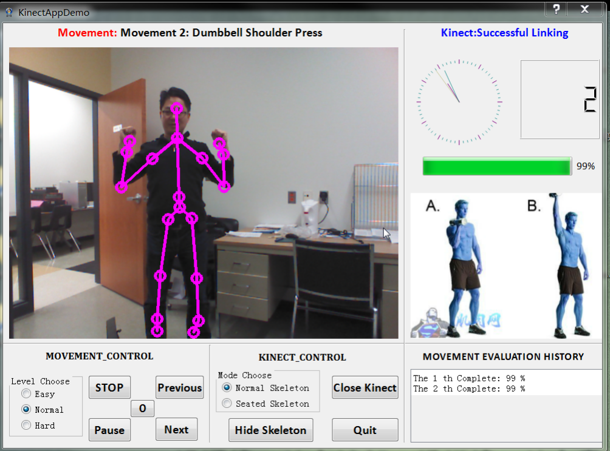
2. GUI Introduction
6 sections:
Status label
Result view
Image view
History view
Kinect Control
Movement control
Obtained
Video Stream
Standard Action

Slide 4
2. GUI Introduction
Status Label
Show the Index and name of current movement
Shows the Kinect states
2. Image Review
Read in Video Stream
Standard Image

Slide 5
2. GUI Introduction
3. Result Viewer
Analog Clock
Counter
Evaluation bar
4. History view
Shows the past evaluation of current movements and records them into a file

Slide 6
2. GUI Introduction
5 Kinect Control
a) Radio Button group of mode
Normal: track whole body
Seated: upper body only
b) Close & Open Kinect
c) Quit – kill the process
d) Show & Hide Skeleton
It is strongly recommended to open up the skeleton, which is much helpful to correct your action potentially.

Slide 7

2. GUI Introduction
6 Movement Control
a) Radio Button Group
To set difficulty level.
b) PLAY & STOP
To turn on or off the movement assessment system.
c) Pause & Resume
To pause the color image and whole assessment system.
d) Previous & Next
To choose the next or previous kind of movement.
e) Clear button
To erase the completed times and the evaluations, i.e. restart.

Slide 8



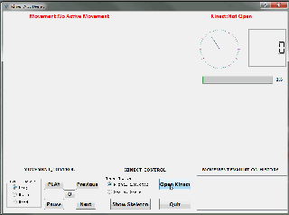
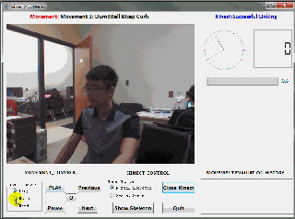
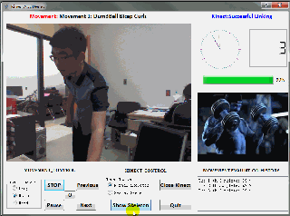
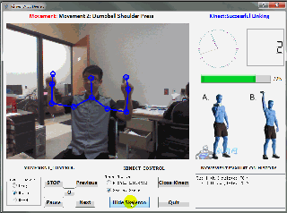
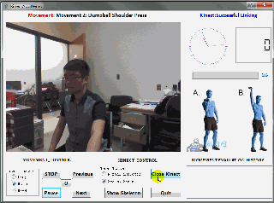
2. GUI Introduction
Refer to the videos:
Recommend using method
Step1: open up Kinect and check status
Step2: Start playing and configure assessment system
Step3: try to use it in different ways.
Step4: Close Kinect and ensure it shut down properly

Slide 9
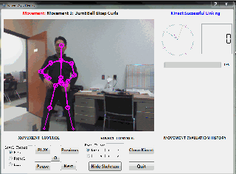
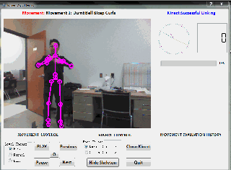
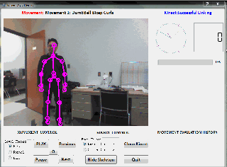
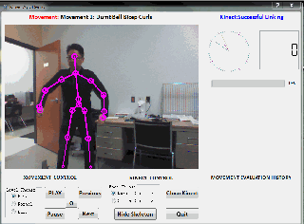

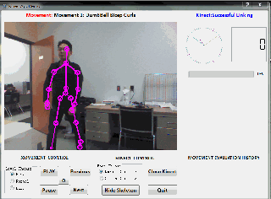
3. Function Test
Action Tracking

Slide 10
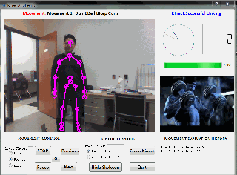
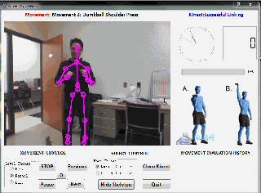
3. Function Test
Counting and Evaluating
Movement1: dumbbell bicep curls
Movement2: dumbbell shoulder press

Slide 11
Kinect Monitor ++
End
Still Under Developing

